Slide 1

CT Attenuation Correction for PET imaging
John Hayes
Dec 16, 2015

Slide 2
Outline
Motivation for attenuation correction (AC)
Current best practice: CT-based AC
Advanced techniques
Dual Energy
Metal Artifact Reduction
Interative Reconstruction
Photon Counting Detectors
Conclusion

Slide 3
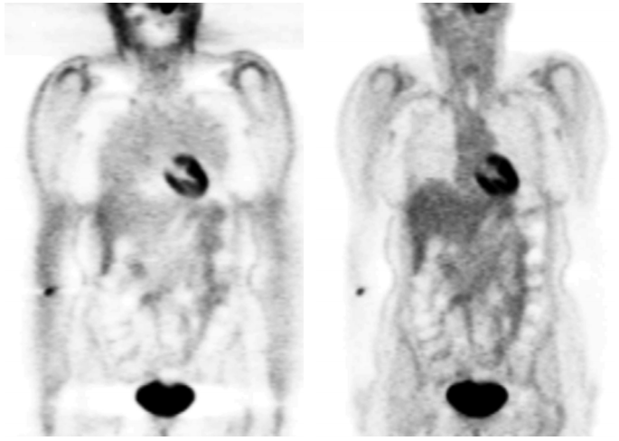
Motivation: Attenuation Correction (AC)
without AC
with AC
Image: R. Schmitz, A. Alessio, P. Kinahan

Slide 4
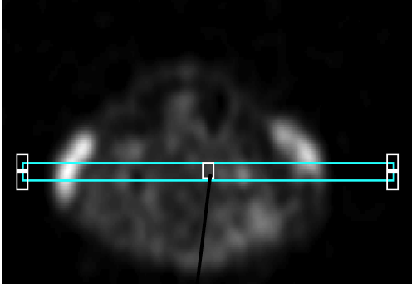
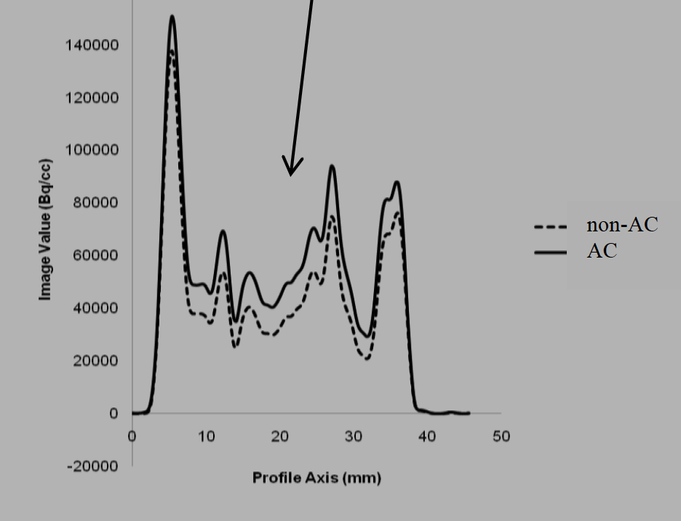
AC necessary regardless of size
non-AC underestimates activity concentration in image by up to 20%
Images: Ali et. al.

Slide 5
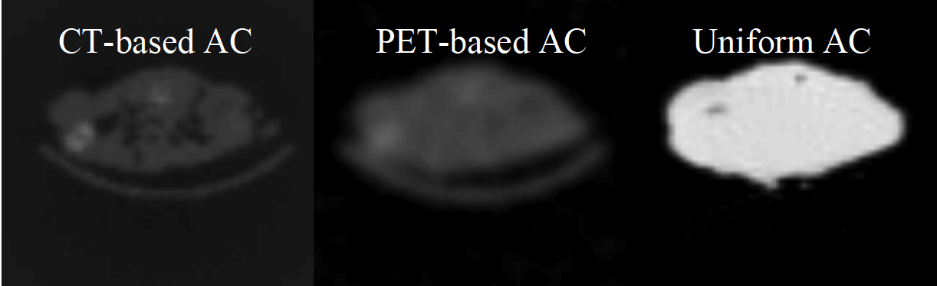
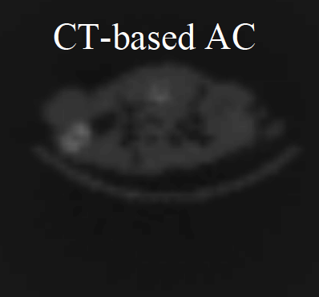
CT-based AC
Higher spatial resolution
Less noise
Less time than PET transmission image
CT-based AC preferred
Images: Ali et. al.

Slide 6
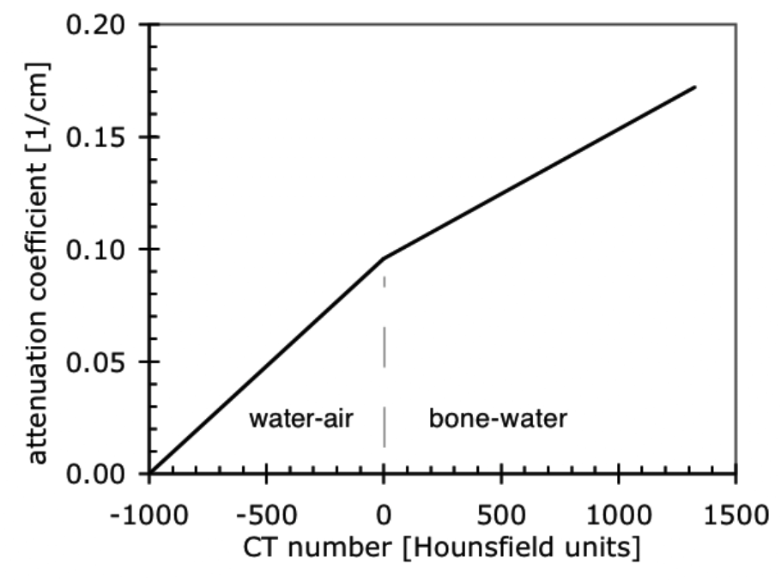
Current practice
Single energy CT image, e.g. 120 kVp
Hounsfield units (HU) converted to μ at 511 keV
But only based on two materials
Not a 1-to-1 HU to mu correlation
Artifacts from
contrast agent
metal implants
motion
Bilinear transformation method
Image: R. Schmitz, A. Alessio, P. Kinahan

Slide 7
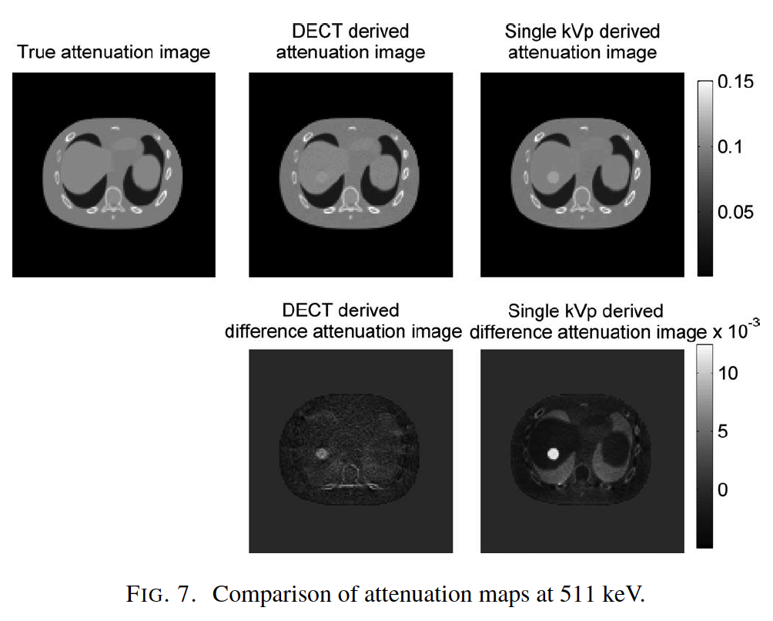
Dual Energy CT
80 kVp and 140 kVp CT scans aquired simultaneously
Recon yields monochromatic attenuation images
Virtual 511 keV attenuation map
Image: Xia et. al.

Slide 8
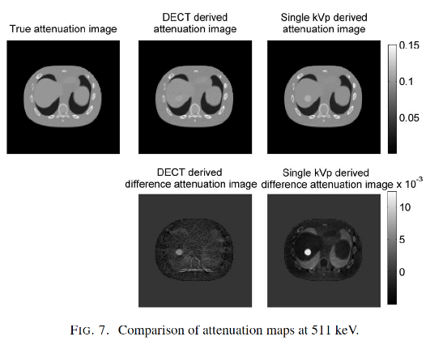
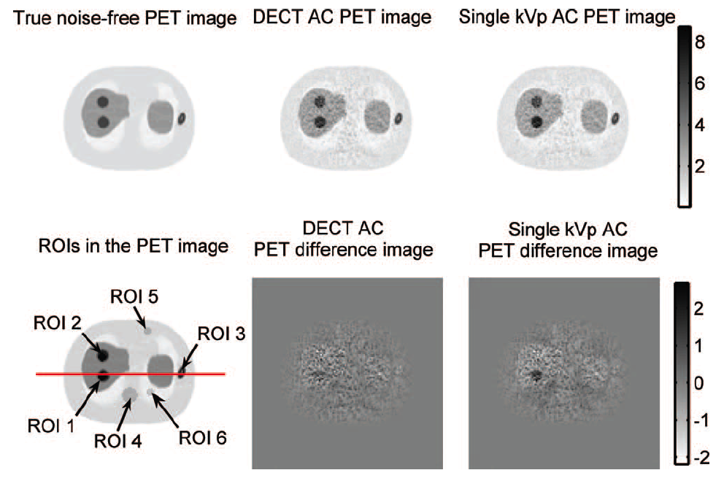
Dual Energy CT
Images: Xia et. al.

Slide 9
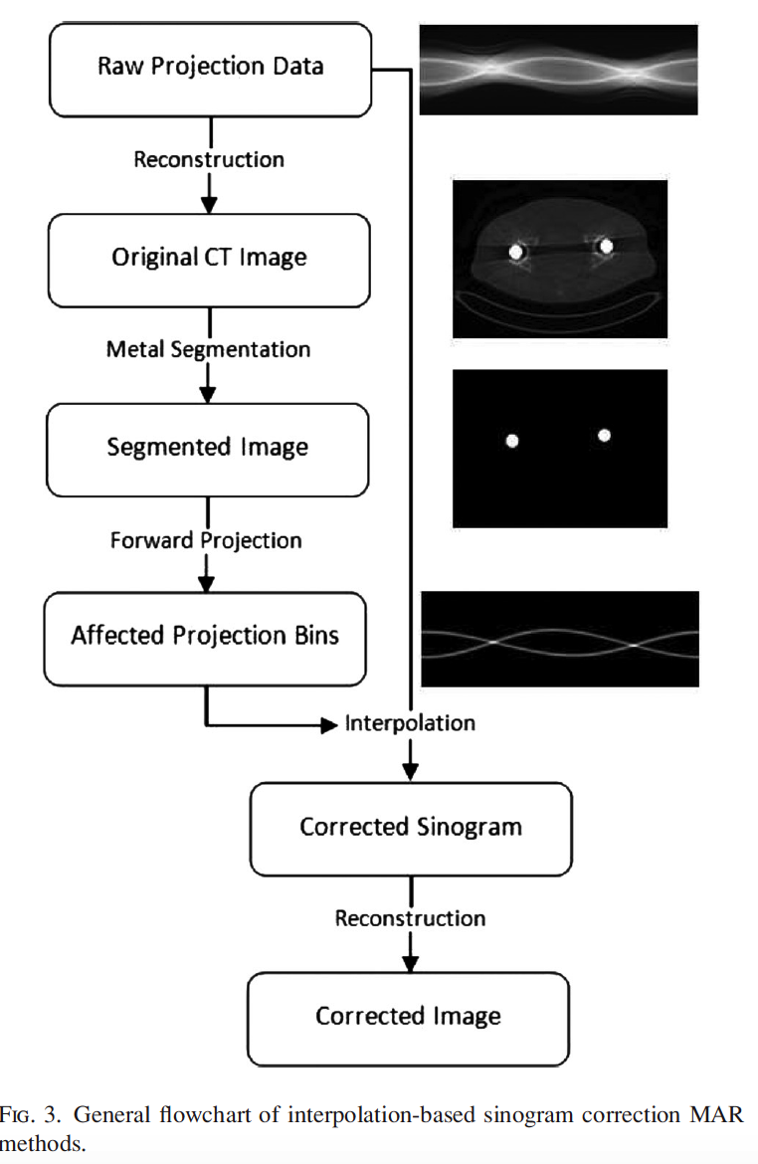
Metal Artifact Reduction (MAR)
Basic form: CT sinogram correction based on segmenting out metal objects and filling in interpolated data
Image: Abdoli et. al.

Slide 10
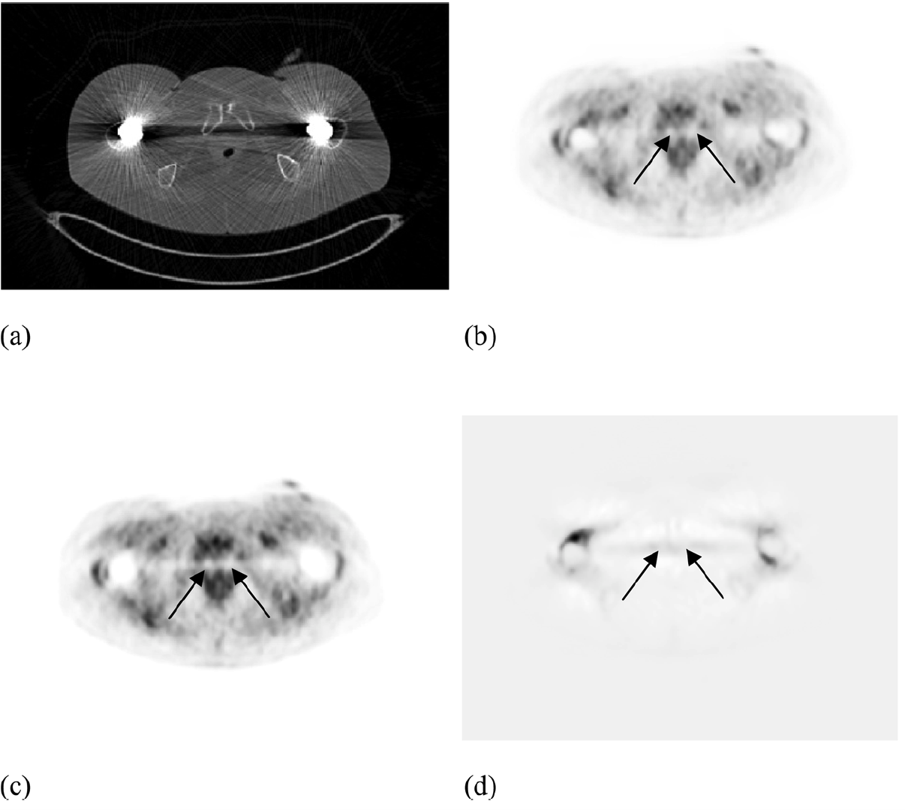
MAR for PET correction
Image: Abdoli et. al.

Slide 11
Iterative Reconstruction
Can significantly lower dose (up to 90%) while still providing the same CT number accuracy as a standard protocol scan
Thus 511 keV attenuation maps (bilinear transformation) provided at lower dose to patient
State of the Art: Adaptive Statistical Iterative Reconstruction (ASiR) by GE

Slide 12
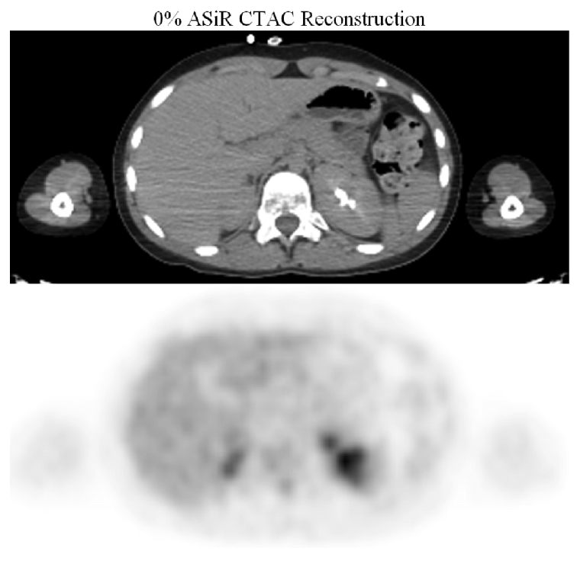
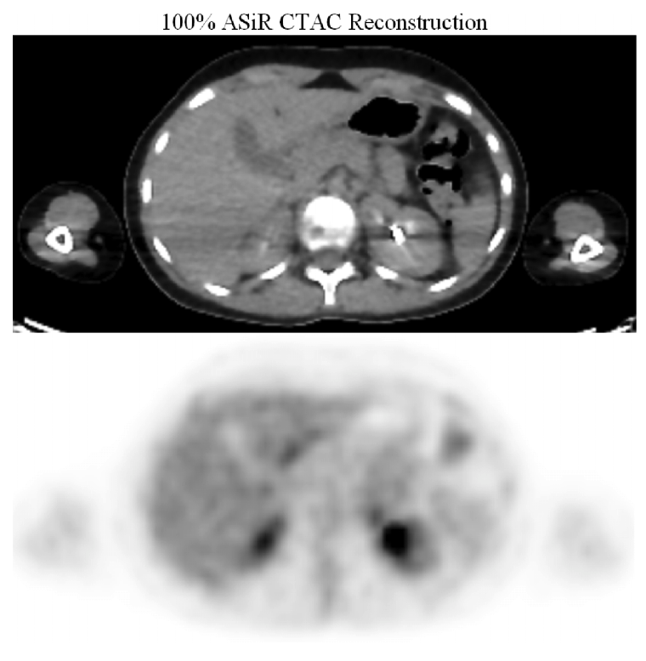
Iterative Reconstruction
FBP
IR (ASiR)
Image: Brady et. al.

Slide 13
Truly Combining PET & CT
Thibaudeau et. al. investigated using the PET detectors for a low resolution CT-scan
65 kVp CT and 511 keV PET concurrent
Counts are separated using photon counting detectors (energy binning)
Iterative reconstruction used to generate best CT image at low dose

Slide 14
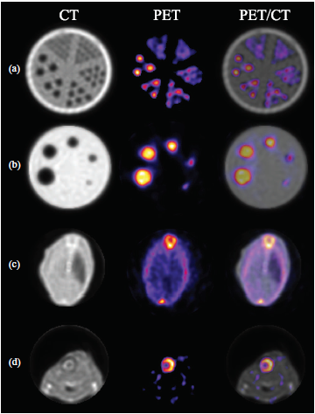
Truly combining PET/CT
Primary benefit is for co-registration accuracy
Can this concept be extended?
Combine this method with Dual Energy CT for more accurate 511 keV map
Can detectors discern 65 kVp, 140 kVp, and 511 keV??
Image: Thibaudeau et. al.

Slide 15
Conclusion
CT-based AC is preferred method for 511 keV attenuation map
Dual Energy CT provides more accurate map than bilinear transformation method
Metal artifact reduction is simple and fast way to recover PET tracer data near metal objects
Iterative reconstruction reduces dose
Photon counting detectors may lead to the best co-registration and attenuation correction in PET

Slide 16
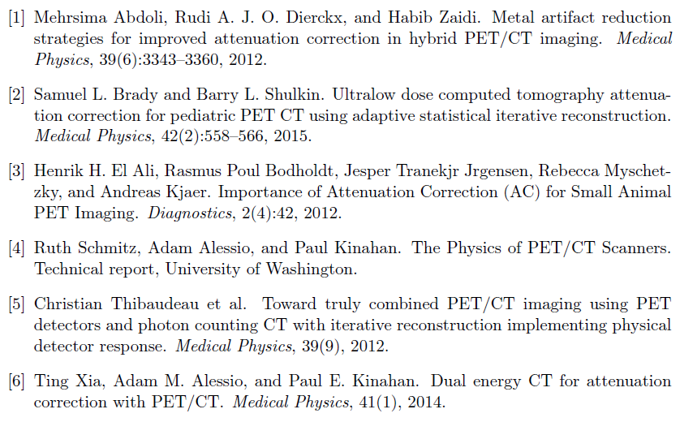
References

Slide 17

Thank You
e

